Slide 1


LANGUAGE TRANSLATOR WEB APPLICATION
Department of Computer Science and Engineering
GE19612– Professional Readiness for Innovation, Employability and Entrepreneurship
Dr. K.Ananthajothi M.E., PhD.,
PROJECT CO-ORDINATOR
PROFESSOR
LAVANYA A (210701132)
MANISHA SHARMI M (210701146)
MEGHA VARSHINEE S J (210701156)

Slide 2
ABSTRACT
A mobile translator app facilitates seamless translation between English and various languages, addressing the longstanding challenge of language barriers in global communication. By leveraging Google's real-time translation API and Java programming, it aims to simplify language learning and promote stress-free communication. Targeting widely spoken languages like English, Spanish, Arabic, Hindi, French, and Chinese, the app caters to diverse user needs, particularly benefiting tourists seeking local integration and access to information. Additionally, the app evaluates translation quality for everyday conversation suitability. Its Android platform ensures widespread accessibility, offering a convenient alternative to traditional language learning methods. Evaluation criteria include classification time, memory usage, and battery life to ensure optimal performance across different usage scenarios.
Department of comuter science and engineering
1

Slide 3
PROBLEM STATEMENT
Language barriers hinder effective global communication in personal, professional, and educational contexts. Existing translation tools often lack accuracy, contextual understanding, and user-friendly interfaces, leading to misunderstandings and limiting their utility. Additionally, many tools fail to provide offline capabilities, crucial for areas with poor internet connectivity. As languages evolve, traditional solutions struggle with new dialects and slang. This project aims to develop a language translator application using advanced NLP and machine learning techniques, specifically
Department of comuter science and engineering
2

Slide 4
PROPOSED SYSTEM
The aim of this project is to develop a highly accurate and user-friendly language translator application to facilitate seamless global communication. The objectives are:
To leverage advanced NLP and machine learning techniques, specifically Transformer models like BERT and GPT, for accurate real-time text and speech translations. •
To design an intuitive interface that supports language detection, voice synthesis, and offline functionality. •
To conduct extensive testing to ensure high performance, accuracy, and user satisfaction
Department of comuter science and engineering
3

Slide 5
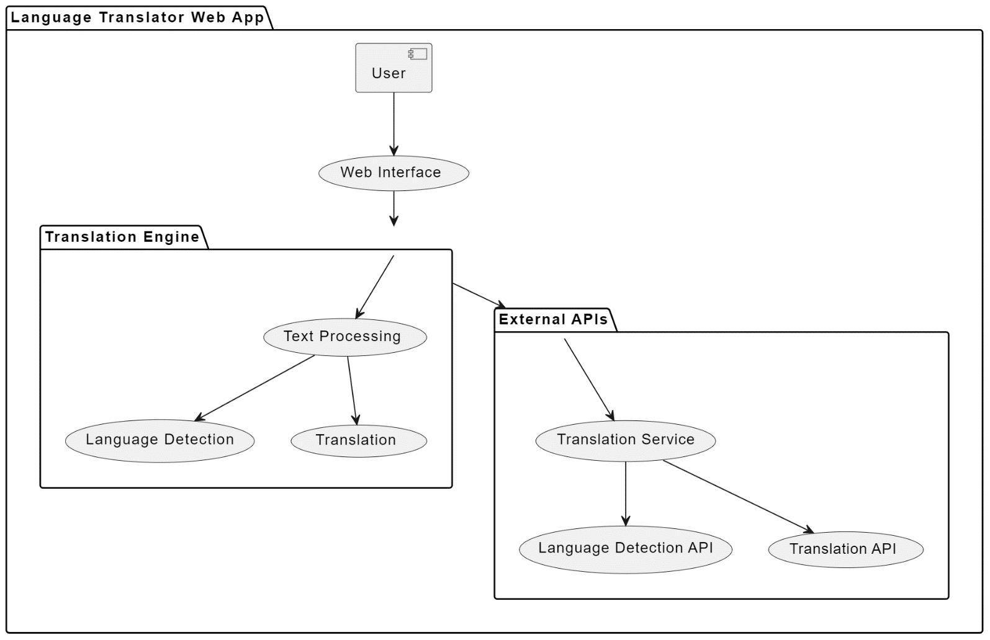
SYSTEM ARCHITECHTURE
Department of comuter science and engineering
4

Slide 6
FUNCTIONAL DESCRIPTION OF MODULE
The language translator application consists of several interconnected modules, each serving a specific function to enable accurate and seamless translation across languages.
Input Module: This module handles user inputs, including text and speech, and preprocesses them for further processing. It incorporates features for language detection to identify the source language and determine the appropriate translation model to use. •
Translation Engine: The heart of the application, the translation engine utilizes advanced NLP techniques, particularly Transformer models like BERT and GPT, to perform accurate and contextually aware translations. It employs techniques such as transfer learning and fine-tuning to optimize translation quality and adapt to various language pairs and domains. •
User Interface Module: The user interface module provides an intuitive interface for users to interact with the application. It supports both text and speech inputs, offering features like language selection, voice synthesis for translated output, and options for offline functionality to ensure accessibility in areas with limited internet connectivity.
Department of comuter science and engineering
5

Slide 7
Model Management: This module manages the deployment and updating of translation models, ensuring that the application always utilizes the latest advancements in NLP technology. it includes mechanisms for model versioning, monitoring performance, and 24 seamlessly integrating new models as they become available. Testing and Evaluation: The testing and evaluation module conducts comprehensive testing to assess the accuracy, speed, and user satisfaction of the application. It includes automated tests for translation quality and user testing to gather feedback on usability and user experience, informing iterative improvements. • Feedback and Improvement: This module collects and analyzes user feedback to drive continuous improvement and refinement of the application. It facilitates collaboration among developers, linguists, and users to address issues, enhance translation quality, and optimize user experience over time.
Department of comuter science and engineering
6

Slide 8
CODE
<!DOCTYPE html>
<!-- Coding By CodingNepal - youtube.com/codingnepal -->
<html lang="en" dir="ltr"> <head>
<meta charset="utf-8">
<title>Language Translator | CodingNepal</title>
<link rel="stylesheet" href="style.css">
<meta name="viewport" content="width=device-width, initial-scale=1.0">
<!-- Font Awesome CDN Link for Icons -->
<link rel="stylesheet" href="https://cdnjs.cloudflare.com/ajax/libs/font- awesome/5.15.3/css/all.min.css"/>
</head> <body>
<div><center><h1>Language translator application</h1></center></div>
<div class="container"> <div class="wrapper"><div class="text-input">
<textarea spellcheck="false" class="from-text" placeholder="Enter text"></textarea>
<textarea spellcheck="false" readonly disabled class="to-text" placeholder="Translation"></textarea> </div>
Department of comuter science and engineering
7

Slide 9
<ul class=”controls”>
<<li class="row from">
<div class="icons">
<i id="from" class="fas fa-volume-up"></i>
<i id="from" class="fas fa-copy"></i> </div>
<select></select></li>
<li class="exchange"><i class="fas fa-exchange-alt"></i></li>
<li class="row to">
<select></select>
31
<div class="icons">
<i id="to" class="fas fa-volume-up"></i>
<i id="to" class="fas fa-copy"></i>
</div> </li> </ul> </div>
<button>Translate Text</button>
</div>
<script src="countries.js"></script>
<script src="script.js"></script>
</body>
</html>
Department of comuter science and engineering
8

Slide 10
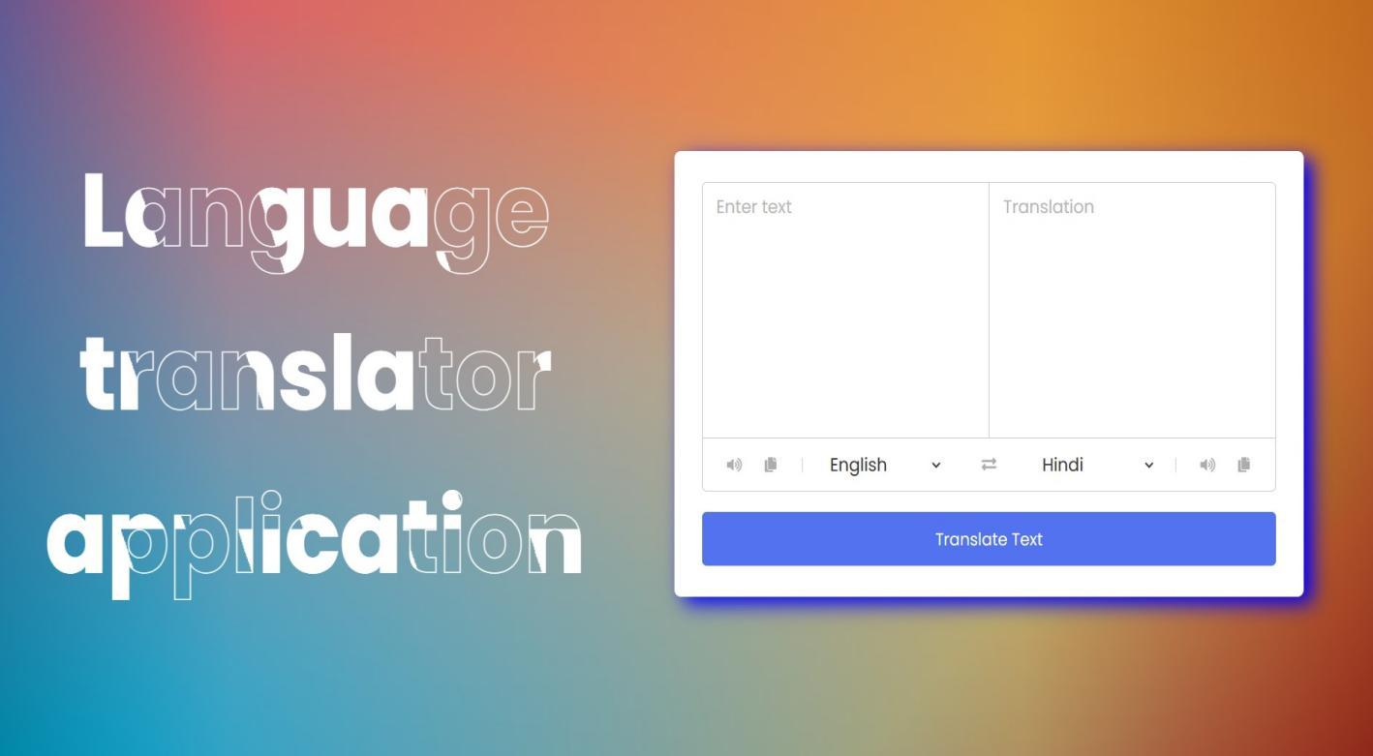
WORKING MODEL
Department of comuter science and engineering
9

Slide 11
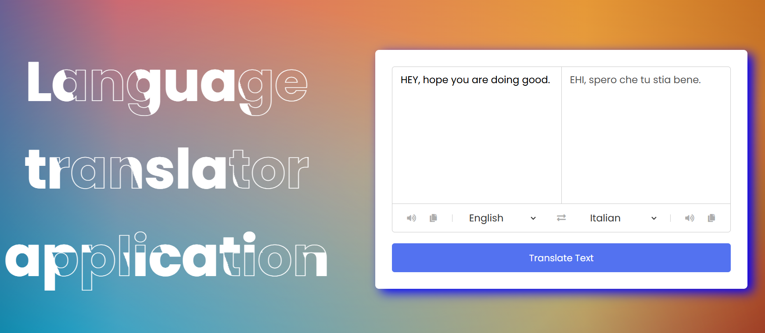
OUTPUT
Department of comuter science and engineering
10

Slide 12
CONCLUSION
In summary, the creation and application of web-based language translators mark a substantial technological achievement with wide-ranging effects on accessibility and international communication. Language barriers and cross-linguistic information access have never been simpler because to these systems' combination of advanced neural network models, creative preprocessing and postprocessing methods, and intuitive user interfaces.
The review of the literature indicates a wide range of research initiatives targeted at improving the user experience, translation quality, and scalability of the system in web-based translation, among other elements of the technology.
Department of comuter science and engineering
11

Slide 13
REFERENCE
1. The effectiveness of machine translation to improve the system of translating language on cultural context MRA Latief, NJ Saleh, A Pammu - IOP Conference Series: Earth , 2020 - iopscience.iop.org
2. A multi-level methodology for the automated translation of a coreference resolution dataset: an application to the Italian language A Minutolo, R Guarasci, E Damiano, G De Pietro - Neural Computing and , 2022 – Springer
3. Design and Application of Intelligent Language Translation Software R Tang, S Wu, X Sun - 2023 2nd International Conference on , 2023 - ieeexplore.ieee.org
4. Speech to Indian sign language (ISL) translation system P Sonawane, K Shah, P Patel, S Shah and intelligent systems, 2021 - ieeexplore.ieee.org
5. Creating a translation application based on CORPUS. M Sapaev - scientific aspects and trends in the field, 2023 - interonconf.org
Department of comuter science and engineering
12

Slide 14
THANK YOU

